Slide 1
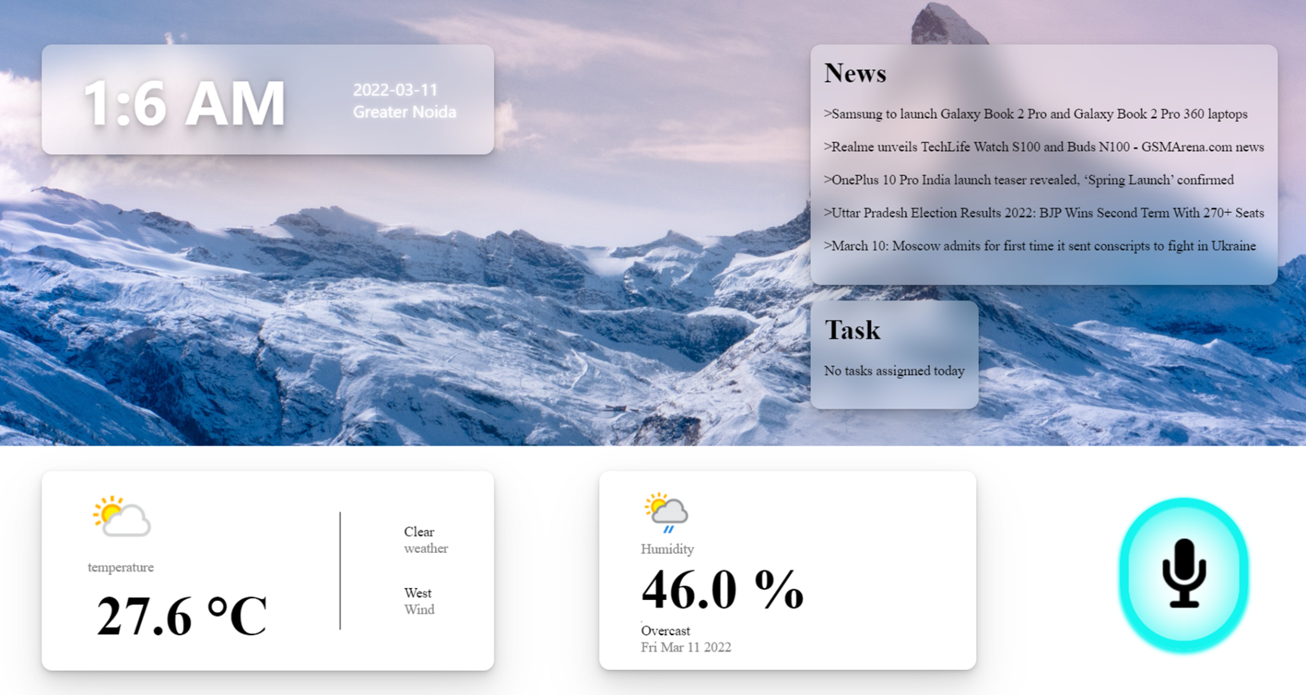
PROBLEM CODE: N/A
Problem Statement: Weather Assistant System
College Code: GCET
Team Leader Name: Pushkar Kumar

Slide 2
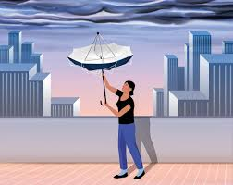
WHY DO WE NEED THIS SYSTEM?
Normally Weather refers to the condition of air on the earth at a given place and time. These properties make weather forecasting boring and useless. Forecasting is the process of estimation in unknown situations from the historical data. Weather forecasting is one of the most scientifically and technologically challenging problems around the world in the last century. To make an accurate, modern and interesting is indeed and will also increase the productivity. Since ancient times, weather prediction has been one of the most interesting and fascinating domains. Scientists have tried to forecast meteorological characteristics using a number of methods, some of these methods being more accurate than others.
But now, we’re living in modern world with internet and IOT devices so why not implementing it in weather so that will make it more interesting and modern. Our weather assistant is modern and contains 2 mode offline and online mode and this system is linked with a Personal voice assistant, so user can interact with it via voice and touch, User Tasks/Reminders makes it more personal.
And talking about our online weather so, Accurate weather forecast models are important to third world countries, where the entire agriculture depends upon weather so they can utilise it for their profit.
The fear of weather has been aggravated due to threat by the global warming and greenhouse effect. The impact of extreme weather phenomena on society is growing more and more costly, causing infrastructure damage, injury and the loss of life So it’ll be good to keep monitoring it.
Weather forecasting is the application to predict the state of the atmosphere for a given location.
In ancient times, forecasting was mostly based on weather pattern observation.
Over the years, the study of weather patterns has resulted in various techniques for rainfall forecasting.
Present rainfall forecasting embodies a combination of computer models, acquaintance of weather patterns.
EXISTING SYSTEMS:

Slide 3
The following technique was used for existing weather prediction.
Use of a barometer:
Measurements of barometric pressure and the pressure tendency have been used in forecasting since the late 19th century. The larger the change in pressure, the larger the change in weather can be expected. If the pressure drop is rapid, a low pressure system is approaching, and there is a greater chance of rain.
Looking at the sky:
Along with pressure tendency, the condition of the sky is one of the most important parameters used to forecast weather in mountainous areas. Thickening of cloud cover or the invasion of a higher cloud deck is an indication of rain in the near future. At night, high thin clouds can lead to halos around the moon, which indicates the approach of a warm front and its associated rain. Morning fog portends fair conditions, as rainy conditions are preceded by wind or clouds which prevent fog formation
Nowcasting:
The forecasting of the weather within the next six hours is often referred to as nowcasting. In this time range, it is possible to forecast smaller features such as individual showers and thunderstorms with reasonable accuracy, as well as other features too small to be resolved by a computer model
Analog technique:
The analog technique is a complex way of making a forecast, requiring the forecaster to remember a previous weather event which is expected to be mimicked by an upcoming event.

Slide 4
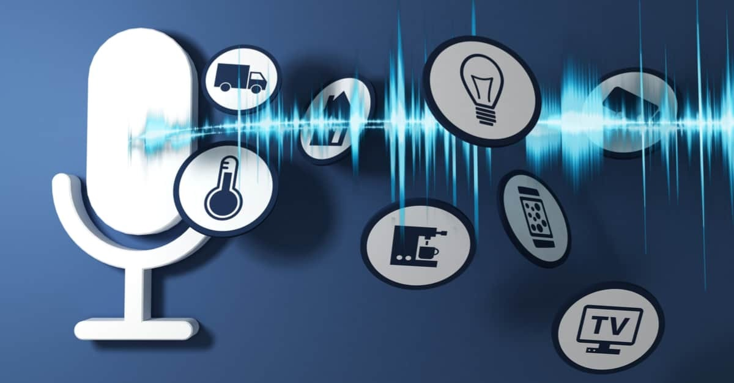

SOLUTION/IDEA:
The idea is to implement a Weather Assistant in Home or Office that will Show Weather (Also time, date, day) on Big Display with Voice Assistant in it, she will tell you about News, Tech News also your reminders/tasks. It will contain 2 modes 1 for showing online weather with APIs and 2- Offline Weather (Home/Office) with the help of sensors connected to raspberry pi and it’ll have its own server. Just one wake up word you can start your morning via knowing about Today’s status, Temperature, and other weather information of your home and will also tell you the latest news or tech news and also tell you and show your daily reminders and tasks, And everything will also show on Display. And it’s just not only a Morning Alarm, but you can also ask about weather anytime, Wikipedia search, and other basic tasks like open YouTube, google and we’ll keep adding things in it as user required. The Assistant will keep listening to you all the time just ask what you needed. This system will increase productivity and will be helpful in offices of Weather-related work like Agriculture and others. Basically, it’ll keep us updated about our weather, news, and tasks. You can also use this as a screensaver, This totally depends on the user, How and where they use
Weather monitoring will be more interesting and interacting
Everyone can get weather in the form of voice and screen
User will get Tasks and Reminders also any type of news
Loss of profits and life that caused by weather will solve by keep monitoring
This is basically also a morning alarm start by Today’s status, Reminding tasks, reminders and also news .
HOW THIS SYSTEMS WILL BE BETTER?

Slide 5
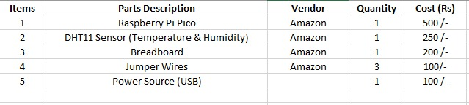
COST ANALYSIS:
DEPENDENCIES:
Raspberry Pi Pico, API for Online reports, DHT11 Sensors, Breadboard, USB, Jumper Wires for connections.
TECHNOLOGY STACK:
IOT, HTML,CSS,JAVASCRIPT,MICRO-PYTHON,PYTHON
USE CASES
Start-up
Shutdown
Report
Calibrate
Test

Slide 6
USE CASE DESCRIPTION
System: Weather Assistant
Use- case: Report
Actors: Weather data collections system, weather station, Voice Recognition
Data: Sensors connected to Raspberry and it is linked to a system via PuTTY ssh and telnet connection it’ll send the live data and saves a summary of data of weather and user can summaries of the weather data that has been collected from the instruments in the collection period to the weather data collection system. The data sent are the maximum, minimum and average temperature and humidity but user can upgrade it to air pressures, the maximum, minimum and average wind speeds, the total rainfall and the wind direction as sampled at 5 minute intervals.
And the data log of sensors will send it to website via flask/django and Voice Assistant will also get the data and speak as per user required
Stimulus: The weather data collection system establishes a modem link with the weather station and requests transmission of the data to Website and Voice Assistant data server.
Response: The summarised data is sent to the weather site and Voice Assistant server
Comments: Weather station are usually asked to report once per hour but this frequency may differ from one station to the other and may be modified in further.

Slide 7
ARCHITECTURAL DESIGN
Once interactions between the system and its environment have been understood, you use this information for designing the system architecture.
Layered architecture is appropriate for the weather station.
Interface layer for handling communications
Data collection layer for managing instruments
Instruments layer for collecting data
There should be no more than 7 entities in an architectural model.

Slide 8
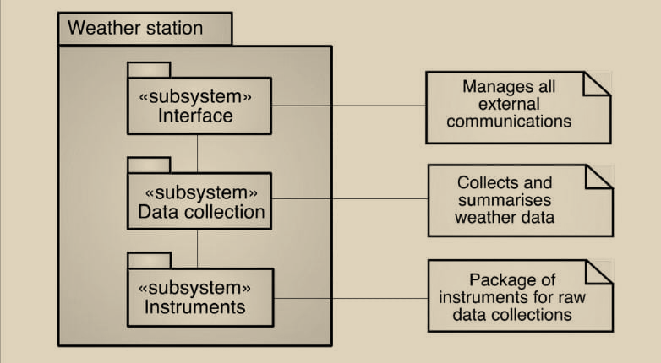
WEATHER STATION ARCHITECTURE
Displays On Display -Website
Voice input and Hardware input
Python Flask and PuTTY
Raspberry Pi Pico , Temperature and humidity sensors

Slide 9
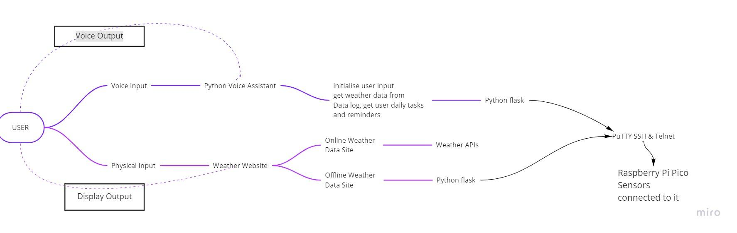
WEATHER STATION ARCHITECTURE

Slide 10
TYPES OF WEATHER FORECASTING
A daily weather forecast involves the work of thousands of observers and meteorologists all over the world.
Meteorologists actually use a combination of several different methods to come up with their daily weather forecasts.
Persistence Forecasting
Synoptic Forecasting
Statistical Forecasting
Computer forecasting
Persistence Forecasting:
The simplest method of forecasting the weather is persistence forecasting.
It relies upon today's conditions to forecast the conditions tomorrow.
This can be a valid way of forecasting the weather when it is in a steady-state, such as during the summer season in the tropics.
This method of forecasting strongly depends upon the presence of a stagnant weather pattern.
It can be useful in both short-range forecasts and long-range forecasts.

Slide 11
Synoptic Forecasting:
This method uses the basic rules for forecasting.
Meteorologists take their observations and apply those rules to make a short-term forecast.
Statistical Forecasting
Meteorologists ask themselves, what does it usually do this time of the year? Records of average temperatures, average rainfall, and average snowfall over the years give forecasters an idea of what the weather is "supposed to be like" at a certain time of the year.
Computer forecasting
Forecasters take their observations and plug the numbers into complicated equations.
Several ultra-high-speed computers run these various equations to make computer "models" which give a forecast for the next several days.
Weather forecasting now has a wide range of operational products that traditionally are classified under the following groups:
Very short-range forecast
Short-range forecast
Medium-range forecast
Long-range forecast

Slide 12
Each weather forecast can be defined on the basis of the following criteria:
Dominant technology
Temporal range of validity after emission
Characteristics of input and output time and space resolution
Broadcasting needs
Accuracy
DATA COLLECTION:
Weather forecasts today depend on collecting and analyzing data and measurements from around the world.
Some of the misclassified data are taken from weatherapi.com, AccuWeather.com, and Weather.com.
It was supported by the meteorologists in analyzing and predicting customized weather forecasts for a city or metropolitan area rather than providing general users with the ability to manipulate and interactively identify possible threats associated with impending weather hazards [HTTP2, HTTP3].
The data set contains fourteen attributes.
They are
Bar Temperature
Bar reading
Station level pressure

Slide 13
Weather forecasting and Crop management
Introduction
The weather at place is always varying with time.
Its variability is not only confined with time scale but also variable with space.
More often; we assume that it behaves as usual as, we expect.
Many a time we come across a situation where the unexpected changes in weather parameters have been observed beyond our expectation.
It is imperative to know when the extreme weather events likely to happen i.e. heavy rainfall, heat and cold waves, occurrence of frost or cloud, high wind and so on so forth either on qualitative or quantitative basis.
Weather forecasting :
It is a science to know that what will be the atmosphere or weather conditions is likely to happen at a particular place at particular time.
Knowing the future weather conditions of a particular place at particular time with certain probability is known as weather forecasting.
Weather forecast for crop management:
Weather forecasting has been done in Indian province since time immortal.
The ancient ear weather forecasting was based on observation of weather patterns.
Mostly the type of wind and cloud types pattern and its color.
Modern weather forecasting involves a combination of numerical weather models, and statistical tools for quantitative forecasting at different time scale.
Weather plays an important role in agricultural production. It has a profound influence on the growth, development and yields of a crop, incidence of pests and diseases, water needs and fertilizer requirements.
The most common one is delay in start of the crop season due to delay in monsoon onset in rainfed regions of India and temperature changes or high temperature differences or early cessation of monsoon.

Slide 14
The effects of weather changes from normal pattern on crops build up slowly but are often widespread enough for destabilize the national agricultural production scenario.
Occurrences of erratic weather are beyond human control.
It is possible to adapt to or mitigate the effects of adverse weather if a forecast of the expected weather can be made in time.
Agronomic strategies to cope with changing weather are available.
However, once the crop season starts and the only option then left is to adopt crop-cultural practices to minimize the effects of mid-seasonal hazardous weather phenomena on the basis of advanced intimation of their occurrences.
Nowcasting: These types of forecast are valid for few hours to one day and more accurate and its area of application is very limited. This type of forecast is mainly used by fisherman.
Short range forecast: This type of forecast is valid for one to three day and area of application is large with more accuracy. This type forecast is mainly used in agriculture, water management and for other use also.
Medium large forecast: This type of forecast is valid for 3 to 10 days and area of applicability is of much large a region or district. This type of forecast is mainly used in agriculture. The forecast accuracy is around 70 per cent. Extended range weather forecasting: This type of forecast is valid for more than 10 days to 4 week. This type of forecast is also used in many areas including agriculture. This type of forecast is mainly related to give an idea of deviation from normal.
Long range forecast: This type of forecast is valid for month to season and large area applicability a state or for combinations of many states. The monsoon forecast is a type of long range forecast.

Slide 15
In India under the network of Gramin Krishi Mausam Sewa projects.
Method of forecasting:
The science of forecasting the weather gets better as new weather satellites are launched into orbit and technology improves.
While using these technologies and API service on web, we are making a system for online weather forecasting system which is use to show the online weather report of any particular location which we want.
And we are also developing an offline system with the help of Raspberry Pi Pico which will be used to show the real time temperature and humidity.
Use of weather forecast in agriculture
Agriculture and farming are mainly dependent on seasons and weather.
The temperature matters a lot in that case when it comes to the farming of different kinds of fruits, vegetables, and pulses.
Now that the technology is developed and special weather forecasting mechanisms are available, the farmers can get all the updates are on a smartphone.
Weather forecasting is a prediction on conditions of atmosphere depending on location and time.
Every area will have their different predictions related to the condition of weather which makes pretty easy for the farmers to know how and what to do when.
The relationship between weather and agriculture has, therefore, necessitated the need for accurate prediction of the weather; to enable farmers to make an informed decision that will not bring losses to them.
It helps to decide whether to undertake or with hold the sowing operation.
Extended periods of dry conditions, commonly known as drought is one of the major impacts in the irrigation system.

Slide 16
Managing under the extreme conditions, irrigators need to understand daily and seasonal crop water use patterns, as well as adopt practices and technology which result in good production of crops.
Weather forecast can help the farmers to decide the timing on when to apply them and in which condition.
Timing of fertilizer has a significant effect on crop yields. Proper timing of the fertilizer application increases yields, reduces nutrient losses and prevents damage to the environment.
Unseasonably high temperatures may lead to lower plant productivity and more pests on the farm.
Weather forecast helps the farmers to know when to apply the pests and chemicals to avoid the crop wastage.

